Slide 1
BOTMAN INTRO
Liam Norman

Slide 2
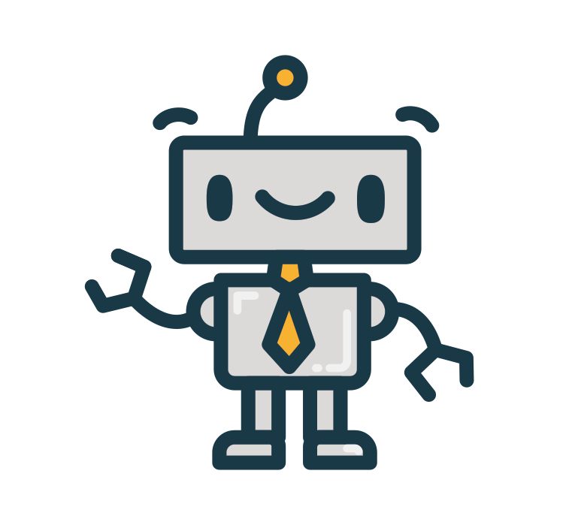

Slide 3
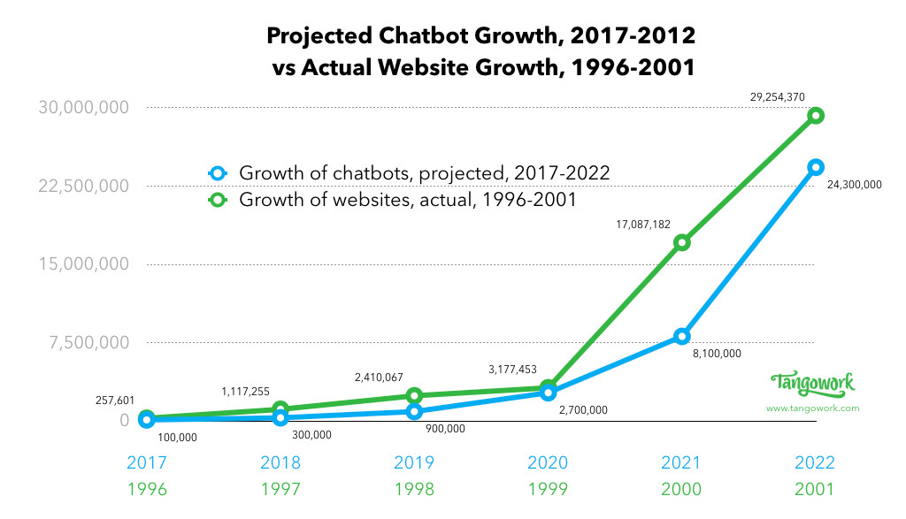
Why use chatbots?

Slide 4
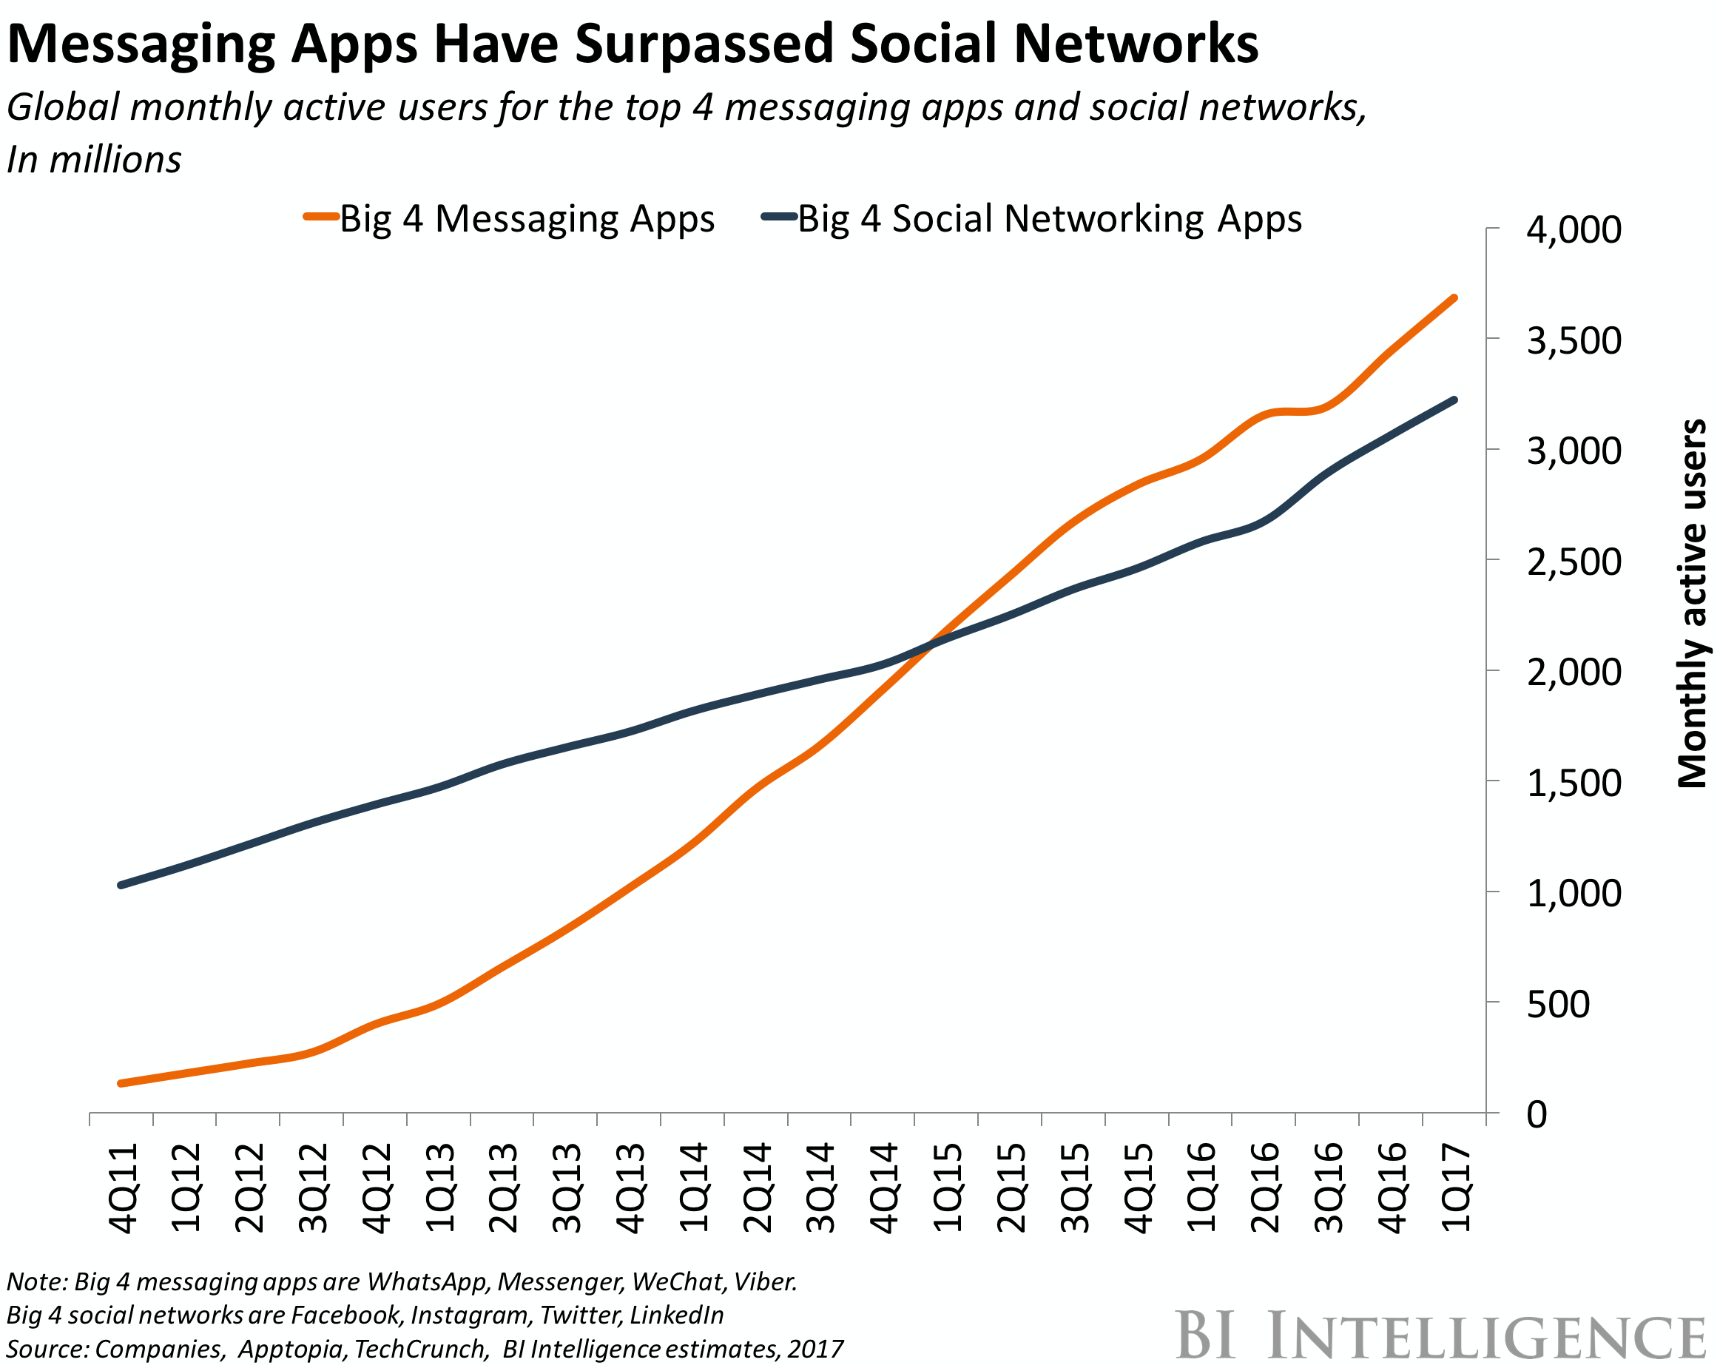

Slide 5
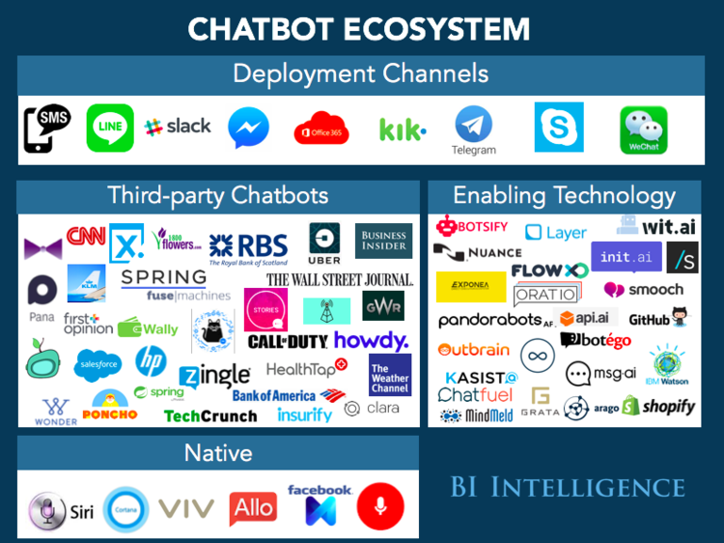

Slide 6
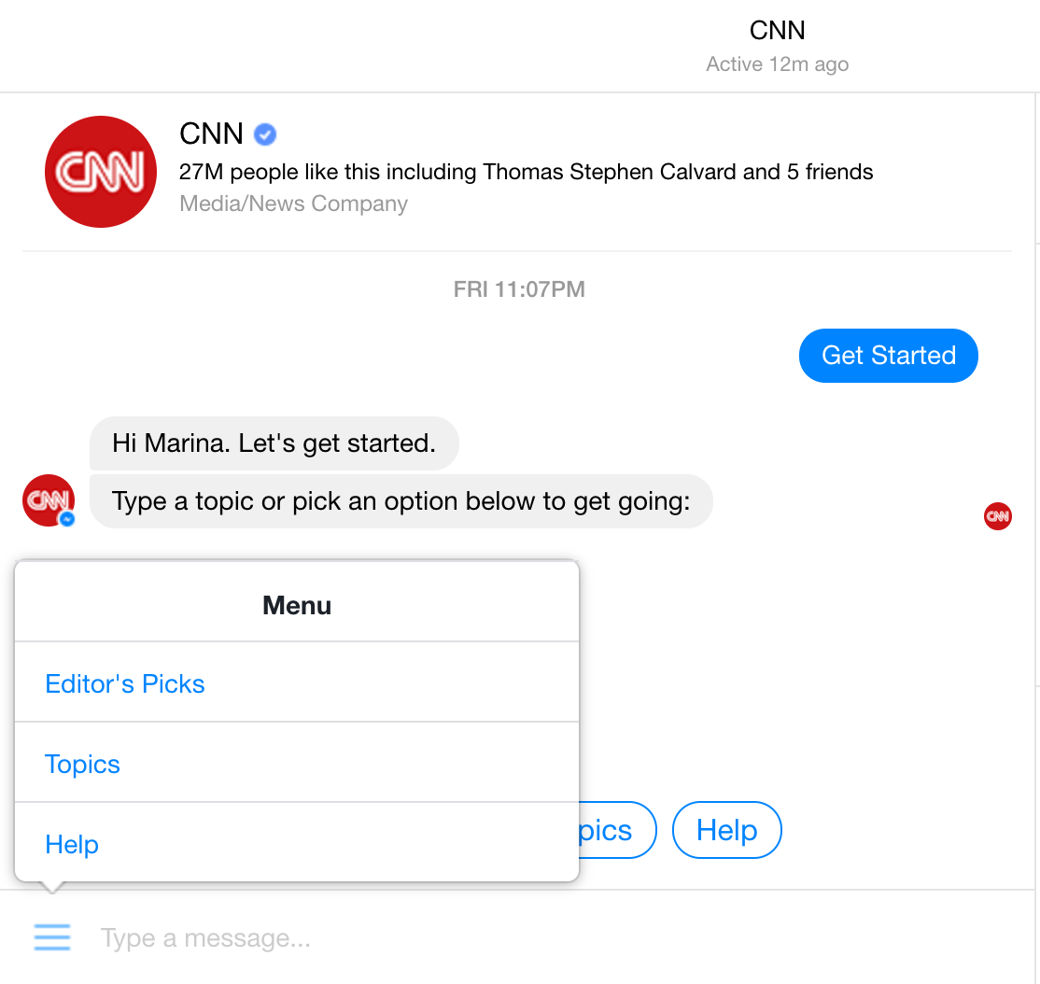
Chatbot usages - Brand marketing

Slide 7
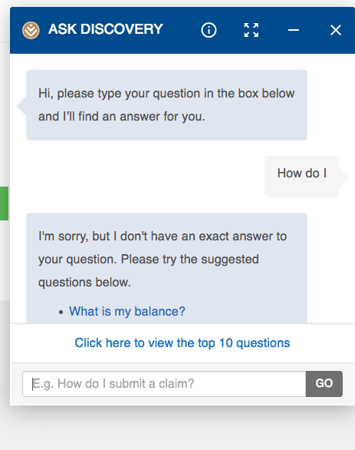
Chatbot usages - SELF SERVICE

Slide 8
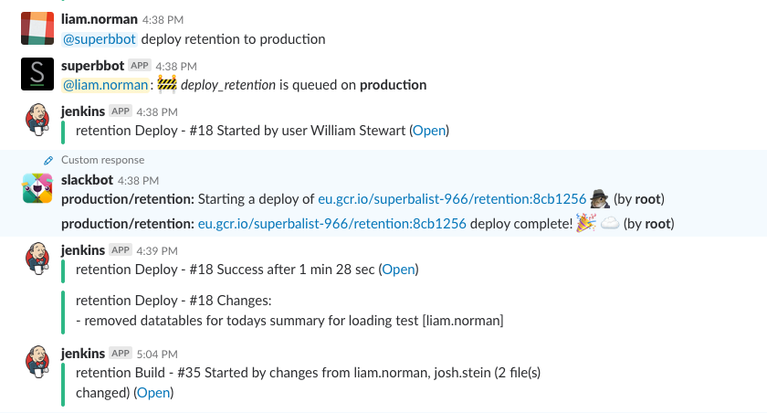
Chatbot usages - DeVops

Slide 9
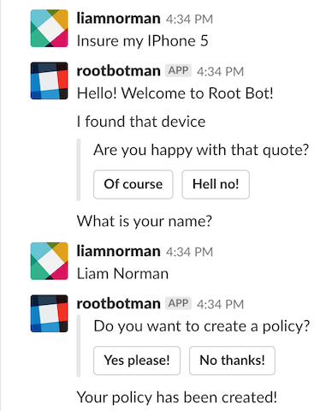
Chatbot usages - FINtech

Slide 10
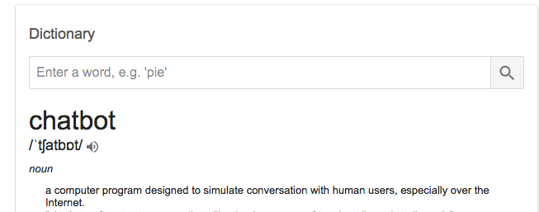

What is A CHATBOT?
A chatbot is a service, powered by rules and sometimes artificial intelligence, that you interact with via an auditory or textual interface.
Chatbots are a conversational interface

Slide 11
How do chatbots work?

Slide 12

WHAT IS BOTMAN?
BotMan is a PHP chatbot framework that is framework agnostic
Offers a variation called BotMan studio which has native support for Laravel
The most popular PHP chatbot framework in the world.

Slide 13

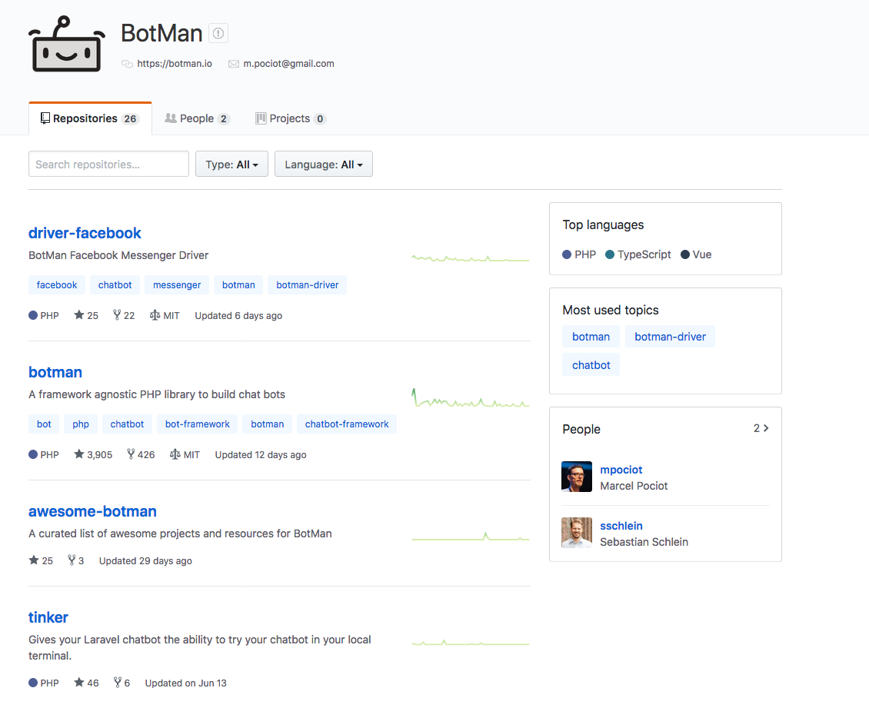
OPENSOURCE DRIVEN

Slide 14
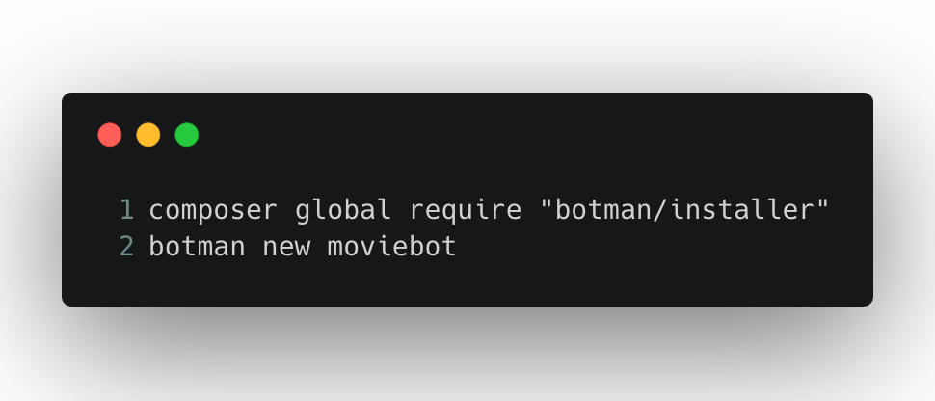
Installing botman using BOTMAN studio
Note: BotMan requires PHP 7

Slide 15
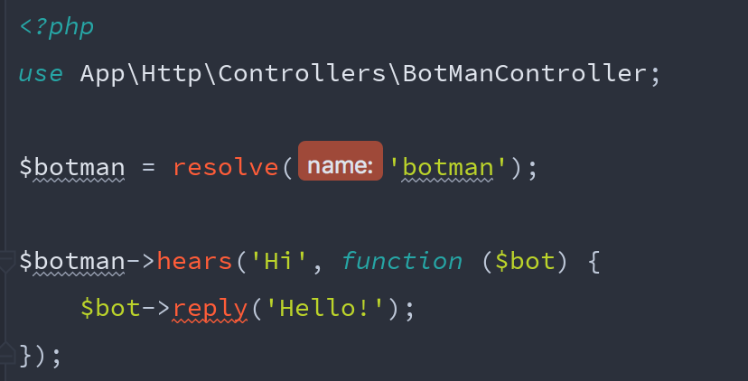
BOTMAN - Listening for Messages
In routes/botman.php

Slide 16
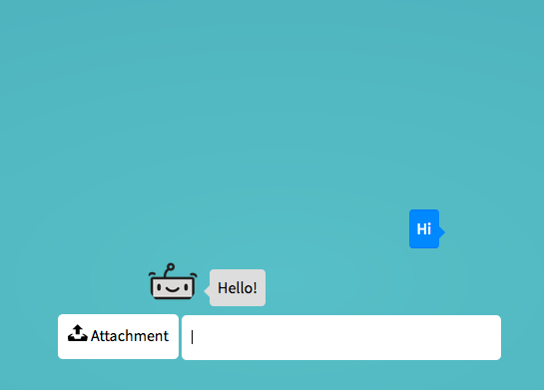
BOTMAN - Tinker

Slide 17
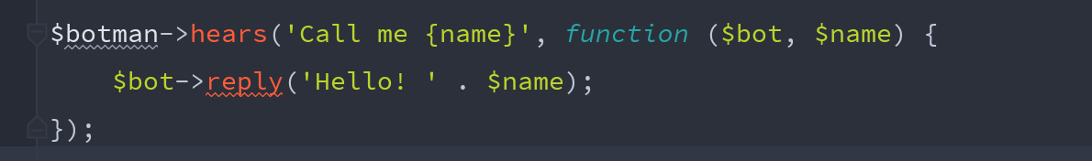
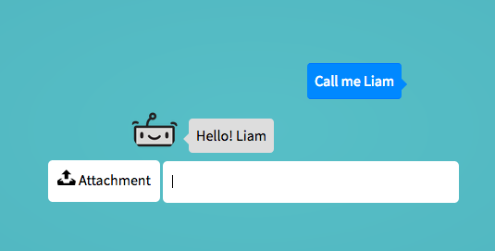
BOTMAN - Listening for Messages
Support for route variables

Slide 18
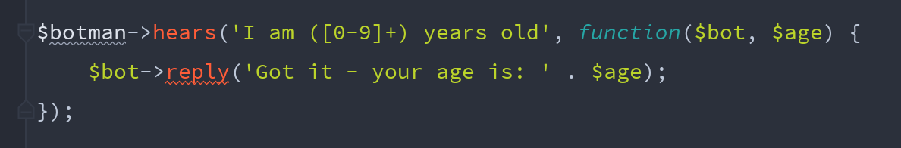
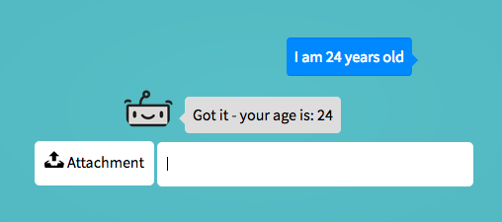
BOTMAN - Listening for Messages
Support for regex expressions

Slide 19
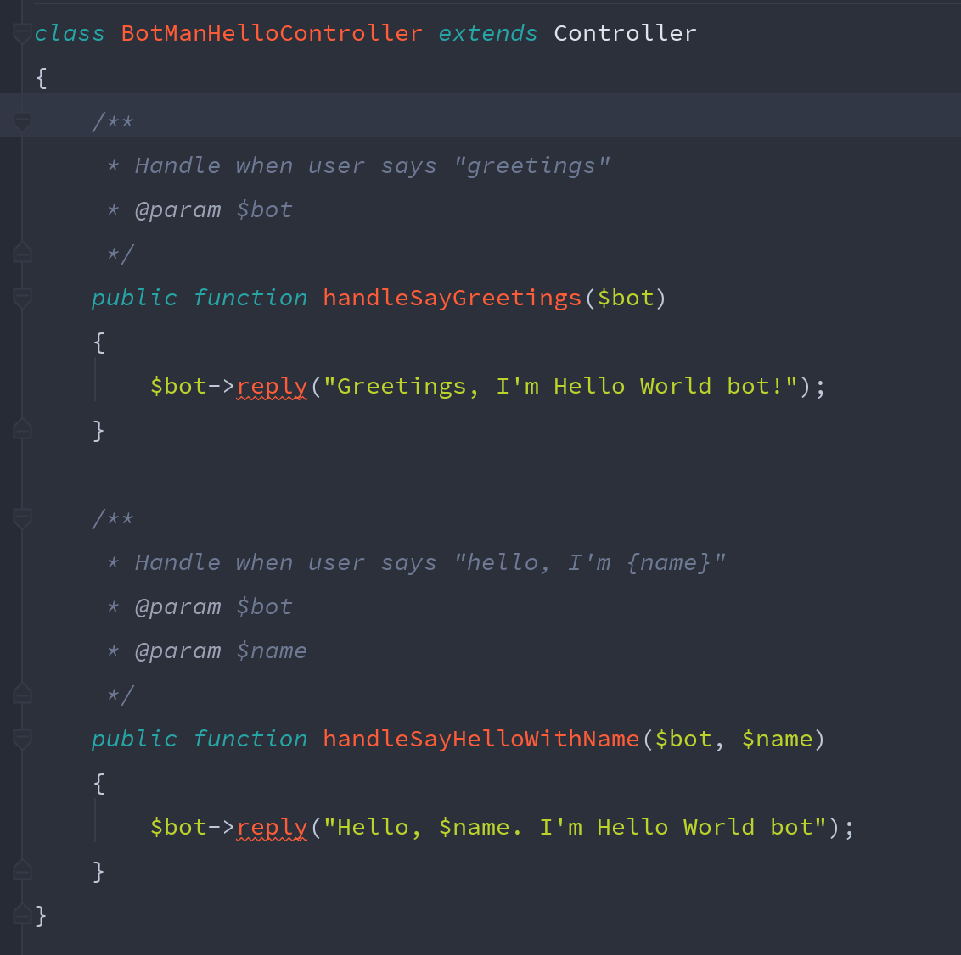
BOTMAN - HANDLING MESSAGES WITH CONTROLLERS

Slide 20
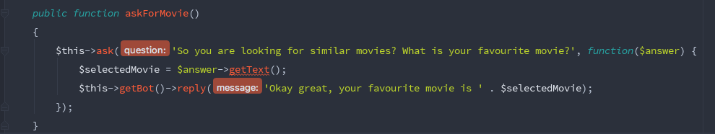
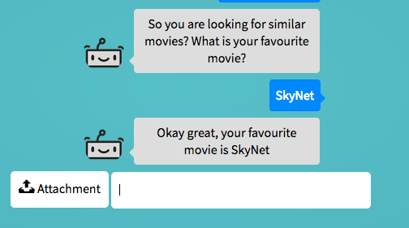
BOTMAN - ASking QUESTIONS
We can very easily ask simple or more interactive questions

Slide 21
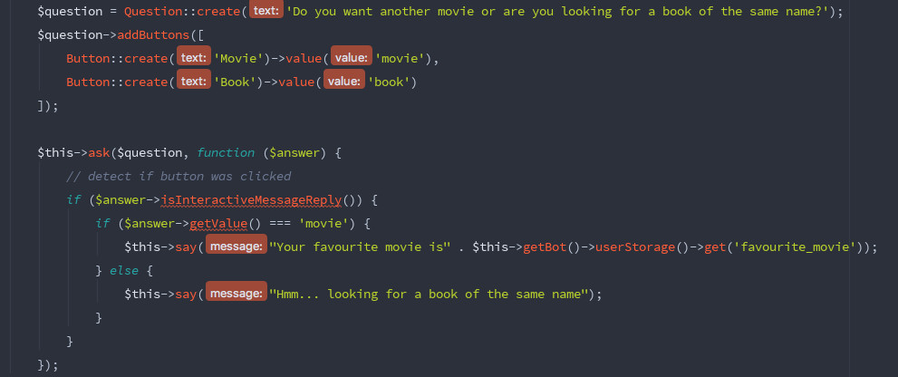
BOTMAN - ASking QUESTIONS
Using native BotMan classes to create an interactive question.

Slide 22
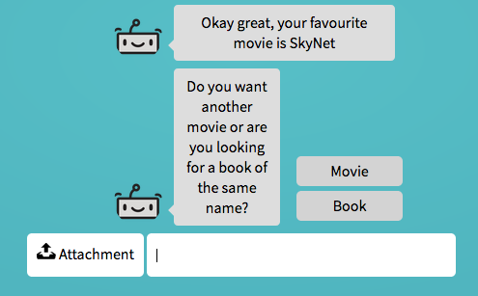
BOTMAN - ASking QUESTIONS

Slide 23
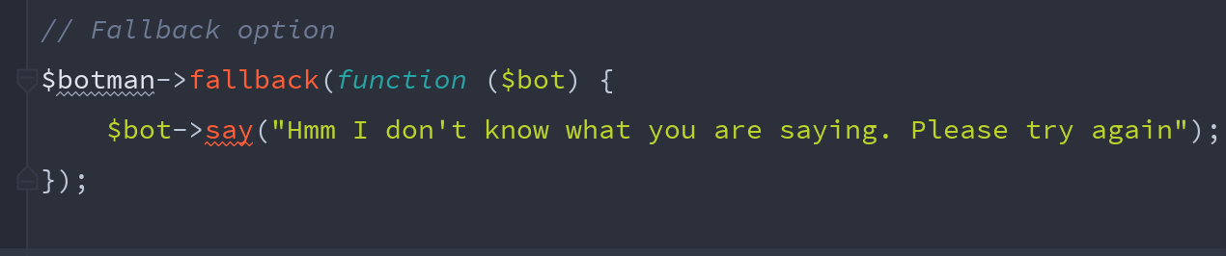
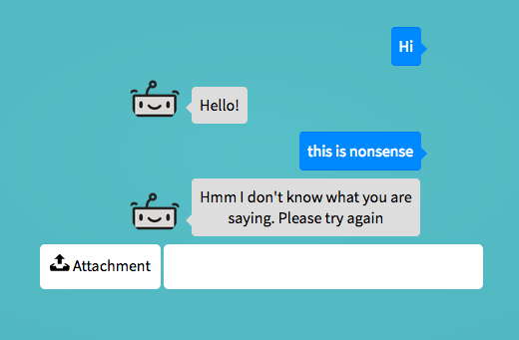
BOTMAN - Default Fallback messages

Slide 24
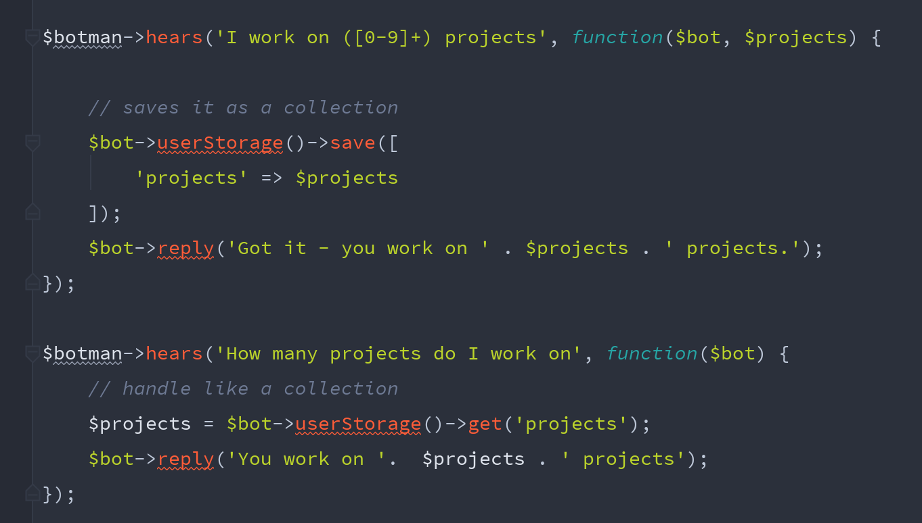
BOTMAN - Storing data
BotMan has a builtin storage system, you can store user, channel or driver specific information. BotMan by default uses a simple JSON file to store data.

Slide 25
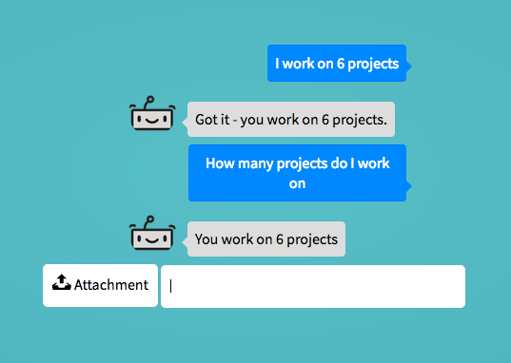
BOTMAN - Storing data

Slide 26
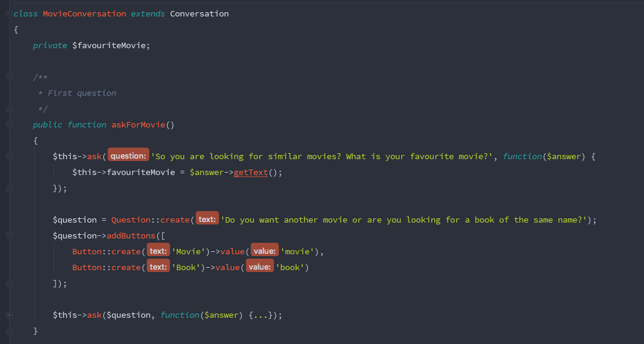
BOTMAN - HAndling conversations
User interaction is not restricted to keywords, we can create conversational flow by using Conversations.

Slide 27
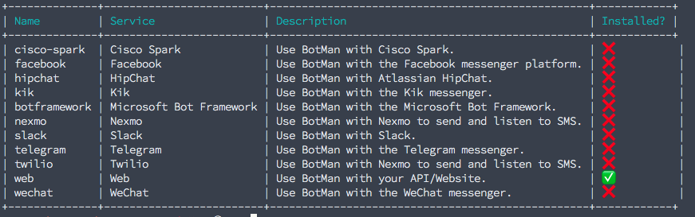
BOTMAN - DRIVERS
Drivers are responsible for message handling between BotMan and chat services.
BotMan natively has drivers for a lot of API’s and NLP frameworks.
Run "php artisan botman:list-drivers” to view all

Slide 28
BOTMAN - Adding DRIVERS
Run "php artisan botman:install-driver slack” to install slack driver
Can write own drivers by extending Driver base class.
Can write own middleware with BotMan.
Setup by creating a Slack App and getting an API token etc…

Slide 29
BOTMAN - ORIGINATING QUESTIONS
BotMan can also originate messages i.e. send messages to specific users.
BotMan can send messages to specific user by targeting their User ID (in the driver context)
BotMan can send messages using a specific driver.

Slide 30
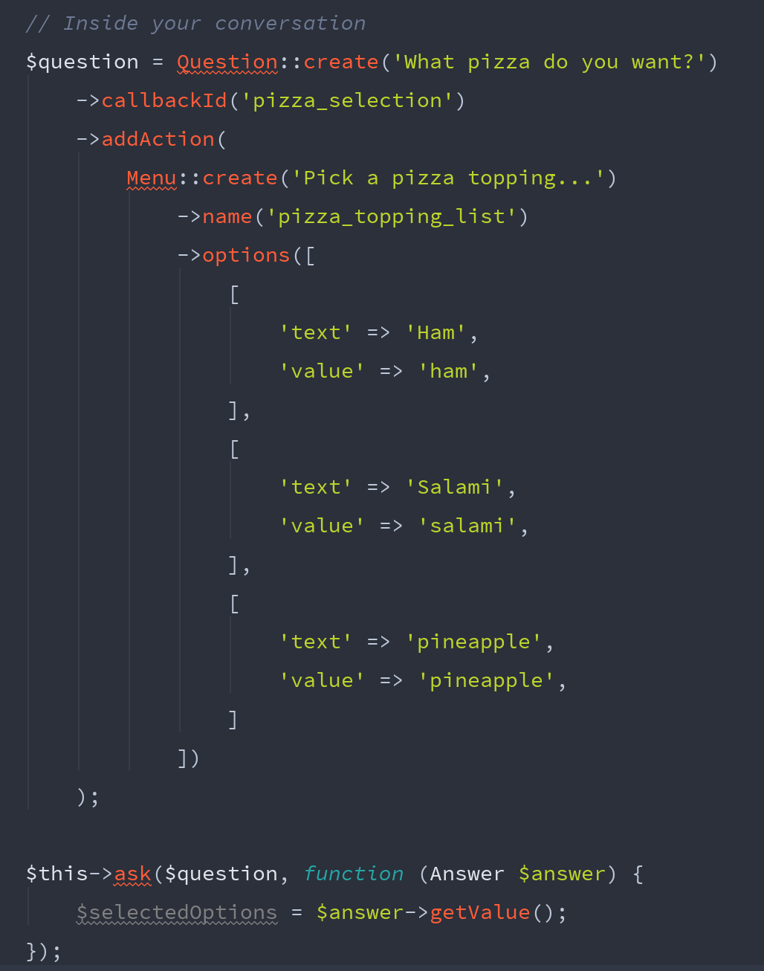
BOTMAN - MENUS

Slide 31
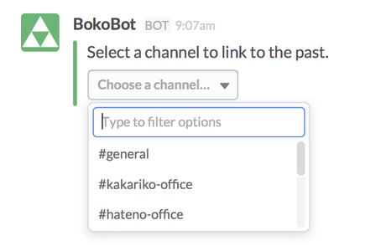
BOTMAN - MENUS
Has native support for interactive menus, very simple to create by passing an array of options.
Menus are limited by the chat service.

Slide 32
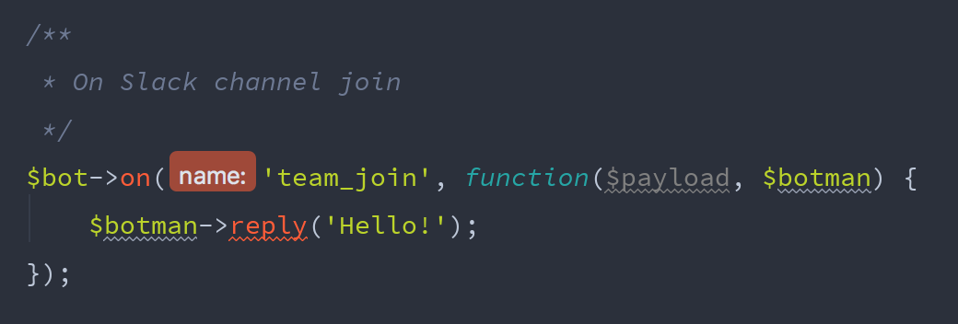
BOTMAN - EVENT LISTENING
BotMan will wait and can detect certain driver events such as for instance when a bot joins a team using outgoing webhooks.

Slide 33


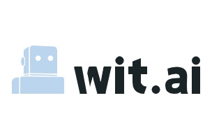

BOTMAN - Natural Language Processing
Support for various NLP services.
The application of computational techniques (often machine-learning) to the analysis and synthesis of natural language.

Slide 34
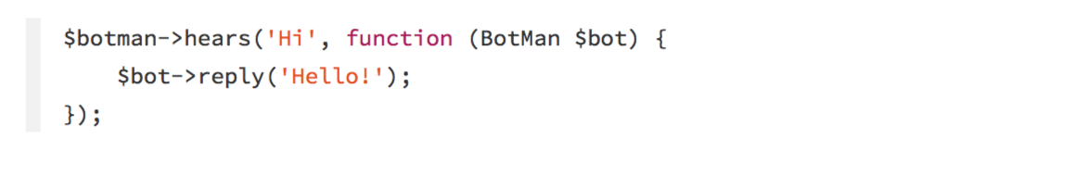
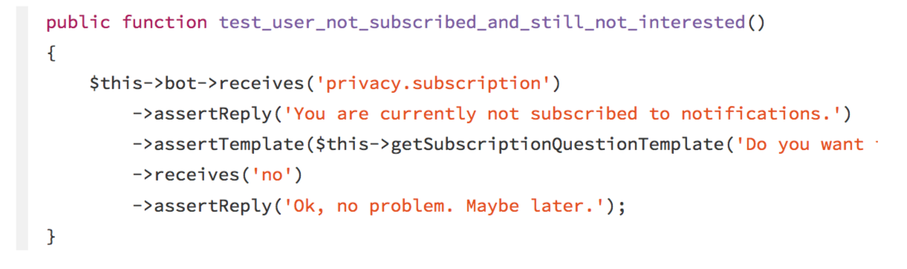
BOTMAN - Testing
Natively uses PHPUnit for TDD
Multiple helper testing methods - assertReply, assertReplyIsNot, assertQuestion etc…

Slide 35
DEMO TIME :)
MOVIe recommendations with BOTMAN

Slide 36
Talk Materials
View the talk materials online here including all the configuration files discussed for my sample BotMan application -

Slide 37
THANKS

